Slide 1

THE BATTLE OF NEIGHBOURHOODS IN TORONTO CITY, ONTARIO, CANADA

Slide 2
PURPOSE OF THE PROJECT
The aim of this project is to help immigrants in determining the neighbourhood that best suits them upon arrival to the province of Ontario, within Toronto city. Their decision on which neighbourhood to choose from, would be based on an analysis of venues in each neighbourhood. This project is for people looking for ease of access to Cafe, Schools, Supermarket, hospitals and so on.

Slide 3
DATA DESCRIPTION
To consider this problem, the list of data considered were:
The Ontario dataset scrapped from Wikipedia on week 3 of this course, was used. The dataset consists of the Postal code, Borough, and Neighbourhood.
Data Link: https://en.wikipedia.org/wiki/List_of_postal_codes_of_Canada:_M
The data was then cleaned, in order to remove any unnecessary data that was found i.e. incomplete data for any borough or neighbourhood.
Another dataset for latitude and longitude was gotten from the data link below: http://cocl.us/Geospatial_data

Slide 4
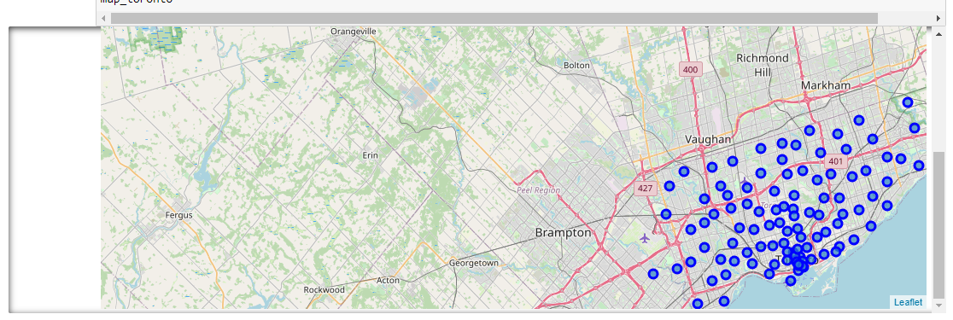
MAP OF TORONTO, FEATURING BLUE MARKERS ON EACH NEIGHBOURHOOD

Slide 5
CONCLUSION
The aim of the project was to examine different neighbourhoods in the city of Toronto, Ontario for immigrants, so as to ensure they make the right choice for the neighbourhood they choose to live in. From the above project, it can be seen that there is a clear analysis of the neighbourhoods, giving the immigrant a clear overview of how each neighbourhood is constructed. With this analysis, the immigrant would be able to make a confirmed choice of his/her preferred choice of neighbourhood.

